Slide 1
Optimizing UAV via Photonic Technology
Student: Jiayao He (Carlos)
Supervisor: Xiaoke Yi
10/11/2017
GitHub: https://github.com/jihe0725/capstone-project

Slide 2
1
Introduction (What?)
｜
2
Background (Why?)
｜
｜
｜
｜
｜
｜
｜
｜
｜
｜
｜
｜
｜
｜
｜
｜
｜
｜
｜
｜
｜
Contents
｜
｜
3
Designs & Achievements (How?)
｜
｜
｜
｜
｜
｜
｜
｜
｜
｜
｜
｜
｜
｜
｜
｜
｜
｜
｜
｜
｜
｜
4
Results (Works?)
5
Questions?

Slide 3
(What?)
Introduction
1

Slide 4
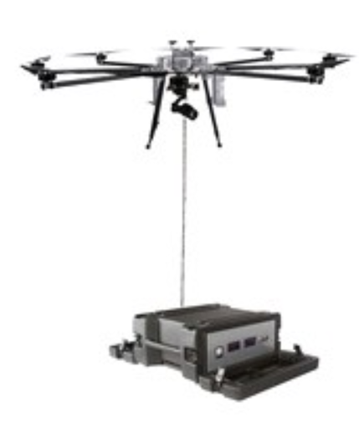

｜
｜
｜
｜
｜
｜
｜
｜
｜
｜
｜
｜
｜
｜
｜
｜
｜
｜
1
Introduction
｜
｜
｜
｜
｜
｜
(What?)
｜
｜
｜
｜
｜
｜
｜
｜
｜
｜
｜
｜
｜
｜
｜
｜
｜
｜
｜
｜
｜
｜
Uplink:
Control signals
Over fibre
from PC ground station to UAV
By the other teammate
Unmanned aerial vehicle (UAV):
The drone
Controlled by ground-based controller
Communication systems
Optical Communication System
Laser Power Supply
Downlink:
Sensor signals
Over fibre
from UAV to PC ground station
By me
Power over Fibre (POF):
Photonic technology
Laser source
Optical fibre

Slide 5
Background
(Why?)
2

Slide 6
｜
｜
｜
｜
｜
｜
｜
｜
｜
｜
｜
｜
｜
｜
｜
｜
｜
｜
2
Background
｜
｜
｜
｜
｜
｜
(Why?)
｜
｜
｜
｜
｜
｜
｜
｜
｜
｜
｜
｜
｜
｜
｜
｜
｜
｜
｜
｜
｜
｜
Wireless UAV
Power Limit
EMI
Data Rates
Electromagnetic
Interference (EMI)
3S battery
Natural
(storms)
Normally in Mbps
5 mins to 20 mins
Intentional
(radar system)
Land and Charge
Decrease with distance
Non-intentional
(equipment)

Slide 7
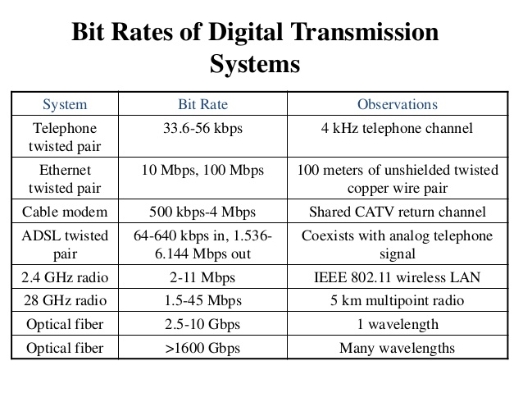
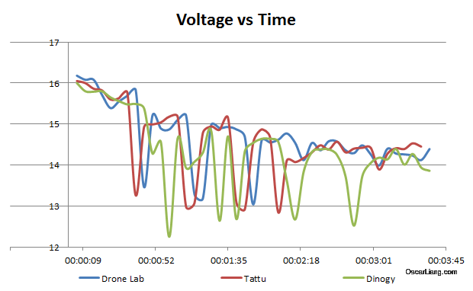
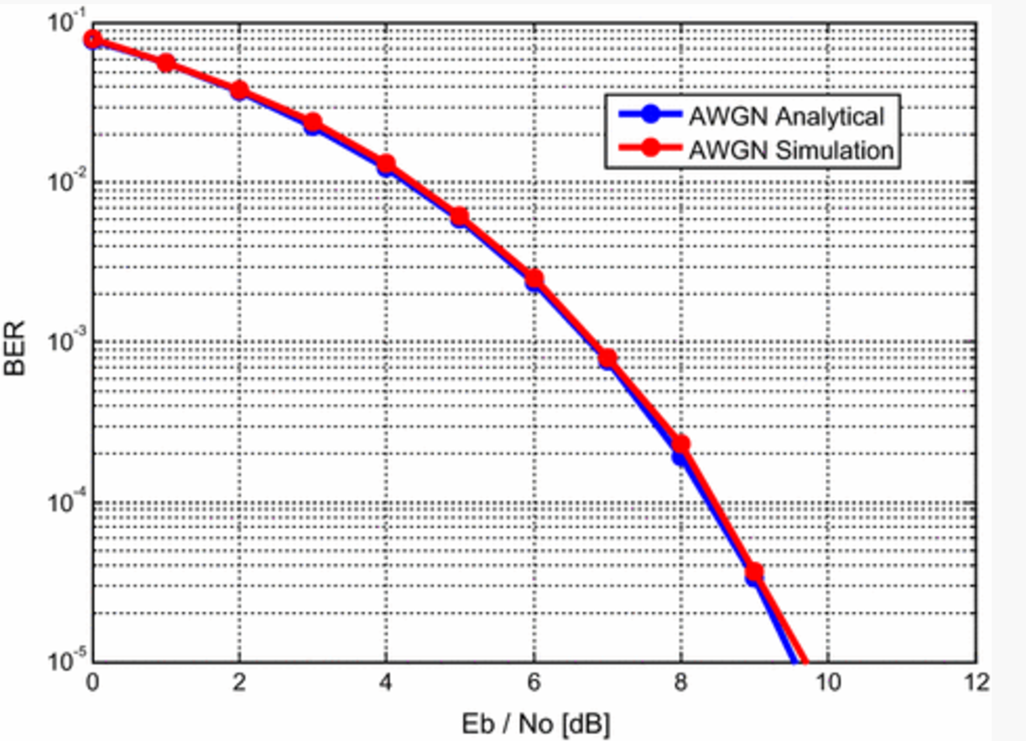
｜
｜
｜
｜
｜
｜
｜
｜
｜
｜
｜
｜
｜
｜
｜
｜
｜
｜
2
Background
｜
｜
｜
｜
｜
｜
(Why?)
｜
｜
｜
｜
｜
｜
｜
｜
｜
｜
｜
｜
｜
｜
｜
｜
｜
｜
｜
｜
｜
｜
Data rates of Transmission systems
Voltage drop V.S Working time of Drones
Applying an AWGN channel to an OFDM radio system
Notes:
an additive white Gaussian noise (AWGN) channel to an Orthogonal Frequency Division Multiplexing (OFDM) radio system
Eb/No为接收机解调门限，定义为每比特能量除以噪声功率谱密度。Eb为每比特信号能量，Eb=S/R，S－信号能量，R－业务比特速率，No为噪声功率谱密度，No=N/W，W－带宽；N－噪音。
Eb:信号比特能量（单位：焦耳/比特）
R：信号传信率（单位：比特/秒）
No：噪声功率谱密度（瓦特/赫兹）

Slide 8
Designs Achievements
(How?)
3

Slide 9
｜
｜
｜
｜
｜
｜
｜
｜
｜
｜
｜
｜
｜
｜
｜
｜
｜
｜
3
Designs & Achievements
｜
｜
｜
｜
｜
｜
(How?)
｜
｜
｜
｜
｜
｜
｜
｜
｜
｜
｜
｜
｜
｜
｜
｜
｜
｜
｜
｜
｜
｜
Temperature Optical Downlink Design
(Delivered PCB)
(Individually)
Laser Power Design
(theoretical)
(Team based)
Semester 2
Video Optical Downlink Design
(Theoretical)
(Individually)

Slide 10
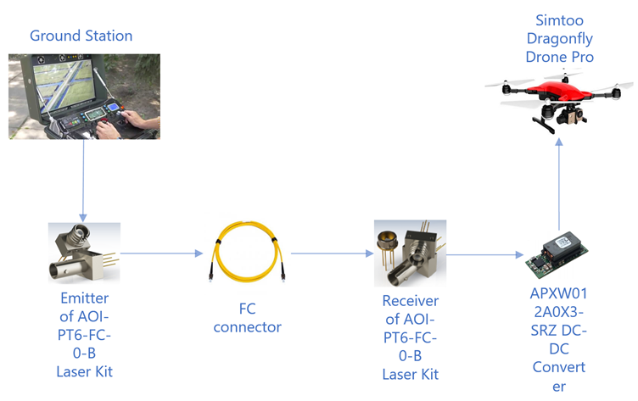
｜
｜
｜
｜
｜
｜
｜
｜
｜
｜
｜
｜
｜
｜
｜
｜
｜
｜
3
Designs & Achievements
｜
｜
｜
｜
｜
｜
(How?)
｜
｜
｜
｜
｜
｜
｜
｜
｜
｜
｜
｜
｜
｜
｜
｜
｜
｜
｜
｜
｜
｜
The System Scheme of Laser Power System

Slide 11
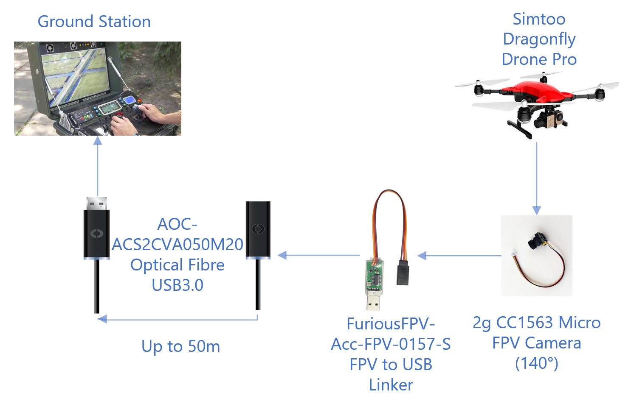
｜
｜
｜
｜
｜
｜
｜
｜
｜
｜
｜
｜
｜
｜
｜
｜
｜
｜
3
Designs & Achievements
｜
｜
｜
｜
｜
｜
(How?)
｜
｜
｜
｜
｜
｜
｜
｜
｜
｜
｜
｜
｜
｜
｜
｜
｜
｜
｜
｜
｜
｜
The System Scheme of Video Optical Downlink Communication System

Slide 12
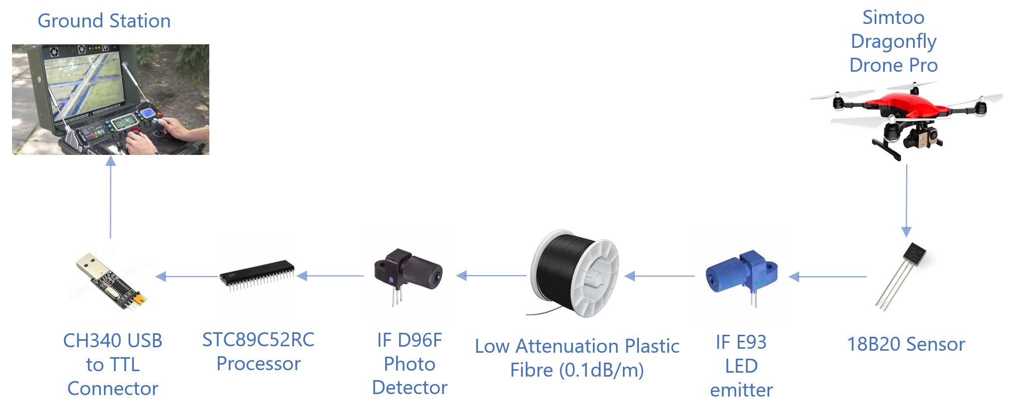
｜
｜
｜
｜
｜
｜
｜
｜
｜
｜
｜
｜
｜
｜
｜
｜
｜
｜
3
Designs & Achievements
｜
｜
｜
｜
｜
｜
(How?)
｜
｜
｜
｜
｜
｜
｜
｜
｜
｜
｜
｜
｜
｜
｜
｜
｜
｜
｜
｜
｜
｜
The System Scheme of Temperature Downlink Communication System

Slide 13
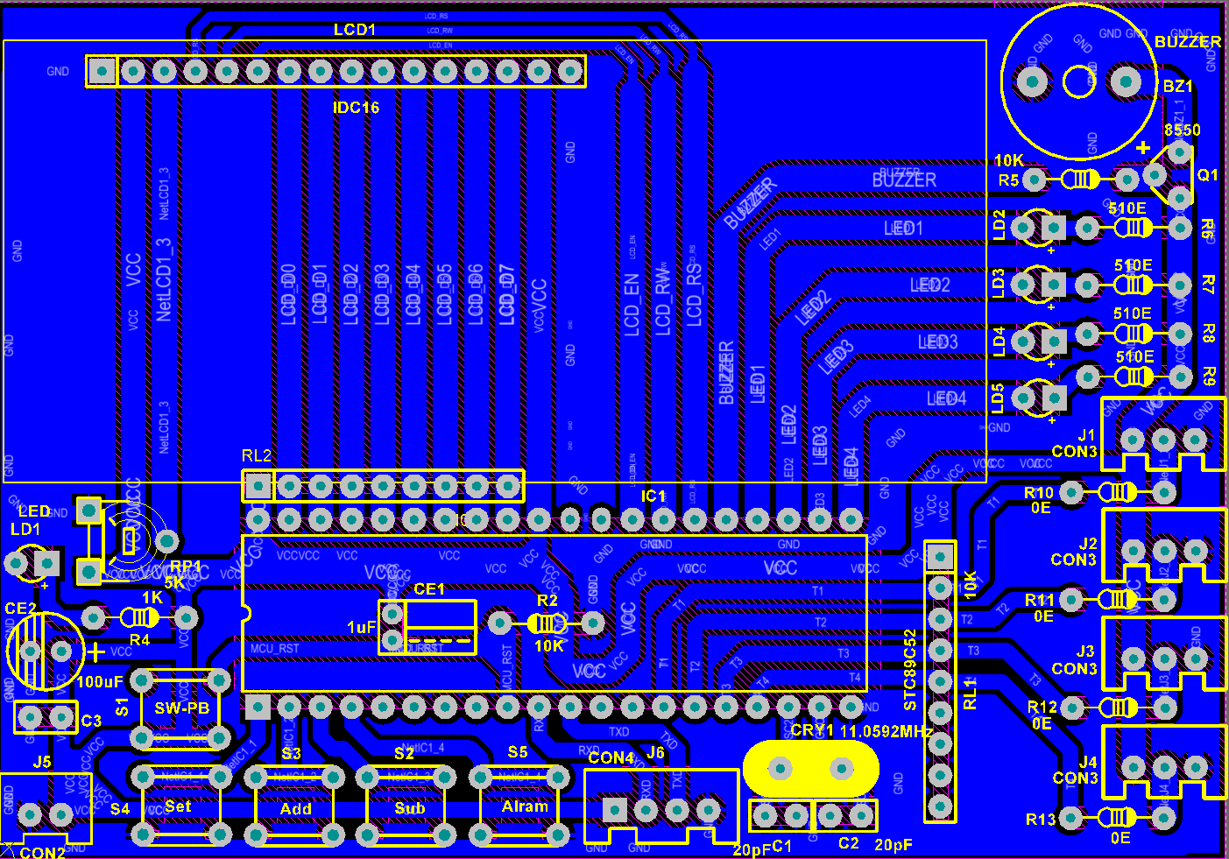
｜
｜
｜
｜
｜
｜
｜
｜
｜
｜
｜
｜
｜
｜
｜
｜
｜
｜
3
Designs & Achievements
｜
｜
｜
｜
｜
｜
(How?)
｜
｜
｜
｜
｜
｜
｜
｜
｜
｜
｜
｜
｜
｜
｜
｜
｜
｜
｜
｜
｜
｜
The PCB Design of Signal Processing System
Notes:
top layer, bottom layer, two mechanical layers, overlap layer, keep-out layer and multi-port layer
OVERLAY
（顶层底层丝印层）
：设计为各种丝印标识，如元件位号、字符、商标

Slide 14
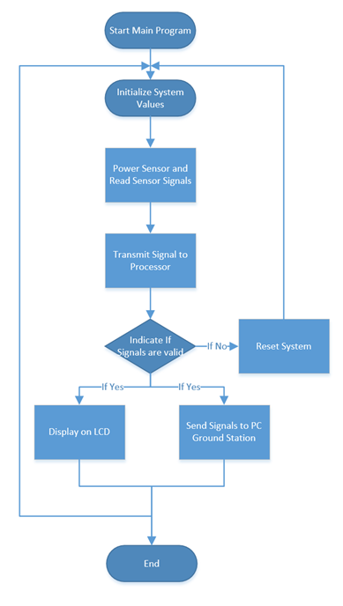
｜
｜
｜
｜
｜
｜
｜
｜
｜
｜
｜
｜
｜
｜
｜
｜
｜
｜
3
Designs & Achievements
｜
｜
｜
｜
｜
｜
(How?)
｜
｜
｜
｜
｜
｜
｜
｜
｜
｜
｜
｜
｜
｜
｜
｜
｜
｜
｜
｜
｜
｜
The System Flowchart of Signal Processing Program
GitHub: https://github.com/jihe0725/capstone-project

Slide 15
Results
(Works?)
4

Slide 16
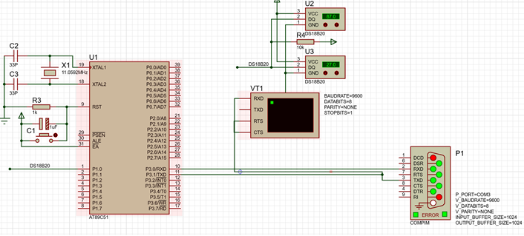
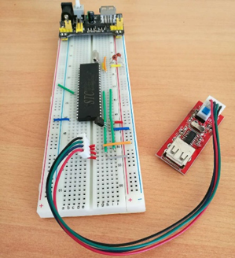
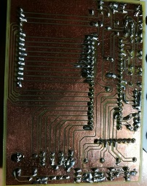
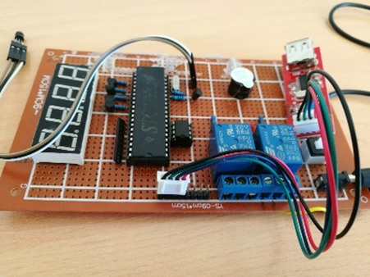
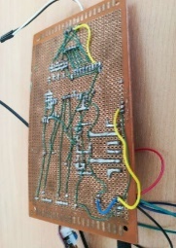
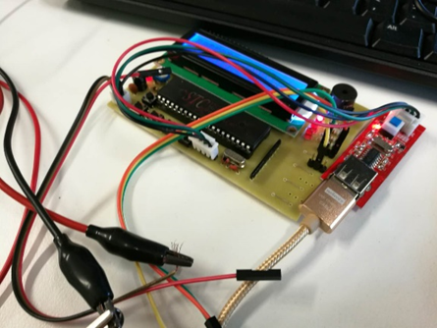
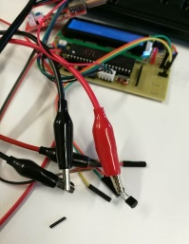
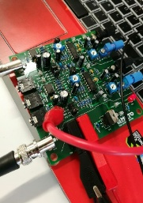
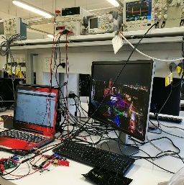
｜
｜
｜
｜
｜
｜
｜
｜
｜
｜
｜
｜
｜
｜
｜
｜
｜
｜
4
Results
｜
｜
｜
｜
｜
｜
(Works?)
｜
｜
｜
｜
｜
｜
｜
｜
｜
｜
｜
｜
｜
｜
｜
｜
｜
｜
｜
｜
｜
｜
Stimulation
Circuit Build
Integration

Slide 17
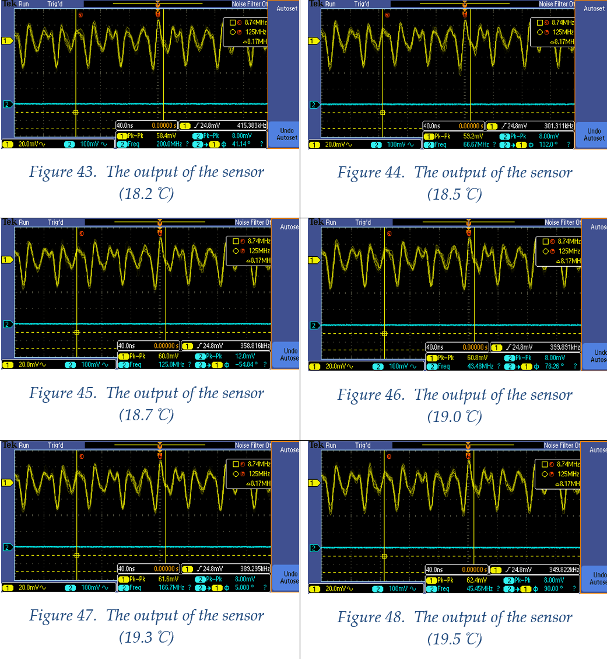
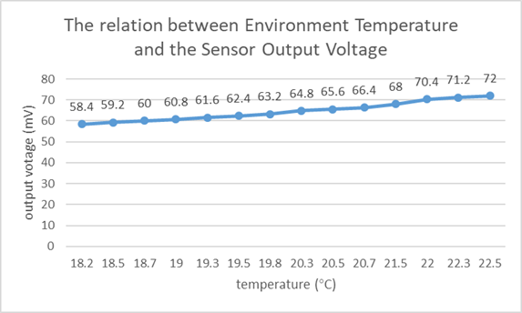
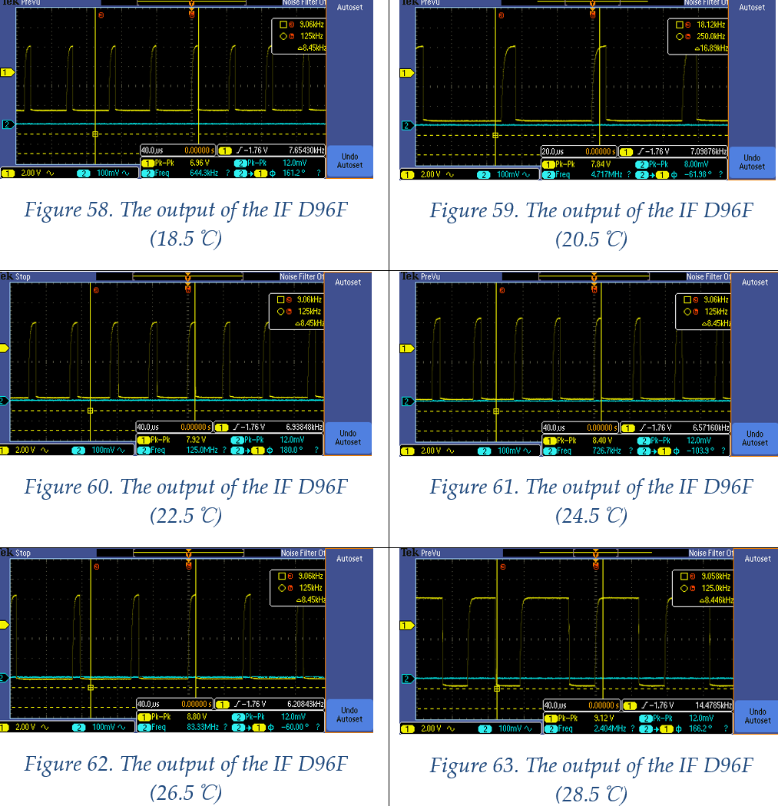
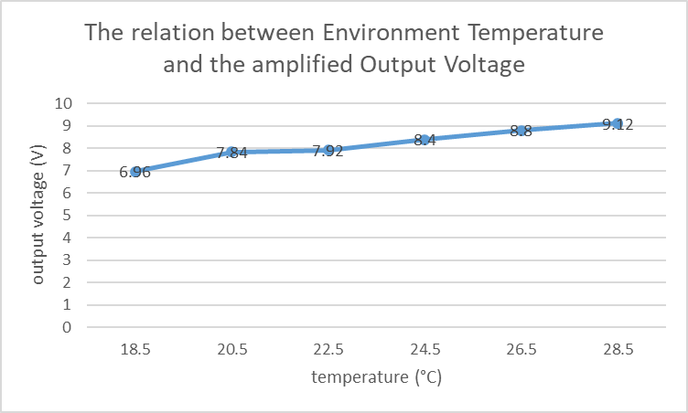

｜
｜
｜
｜
｜
｜
｜
｜
｜
｜
｜
｜
｜
｜
｜
｜
｜
｜
4
Results
｜
｜
｜
｜
｜
｜
(Works?)
｜
｜
｜
｜
｜
｜
｜
｜
｜
｜
｜
｜
｜
｜
｜
｜
｜
｜
｜
｜
｜
｜
Sensor outputs
$$T (℃)=\frac{V_{pk−pk}}{2}∗0.625 (mV)$$
Photo detector outputs

Slide 18
｜
｜
｜
｜
｜
｜
｜
｜
｜
｜
｜
｜
｜
｜
｜
｜
｜
｜
5
Questions
｜
｜
｜
｜
｜
｜
｜
｜
｜
｜
｜
｜
｜
｜
｜
｜
｜
｜
｜
｜
｜
｜
｜
｜
｜
｜
｜
｜
Questions?

